Slide 1
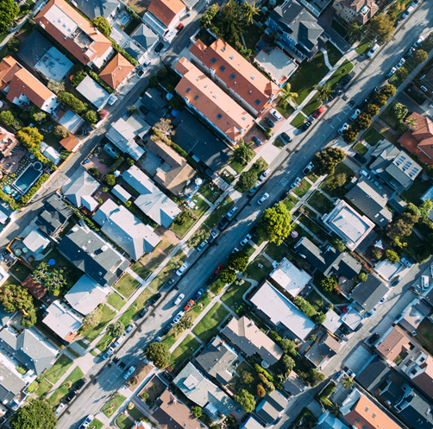
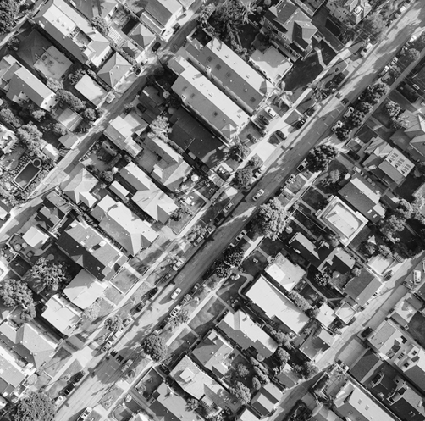
Predicting Housing Prices with the Application of Machine Learning Models
January 2021
Marcus Choi
Ryan Kniewel
Notes:
Marcus

Slide 2
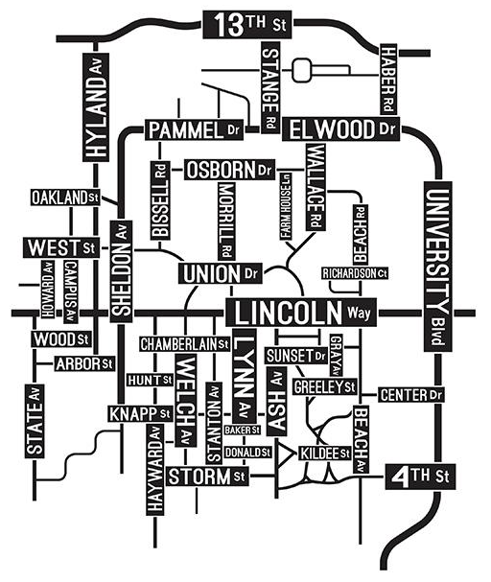
Contents
Contents
Introduction
Objectives & Goals
Exploratory Data Analysis
Pre-Processing
Feature Engineering
Machine Learning Models
Model Performance
Feature Importance
Insights and Conclusion
Future Work
Questions
Notes:
Marcus

Slide 3
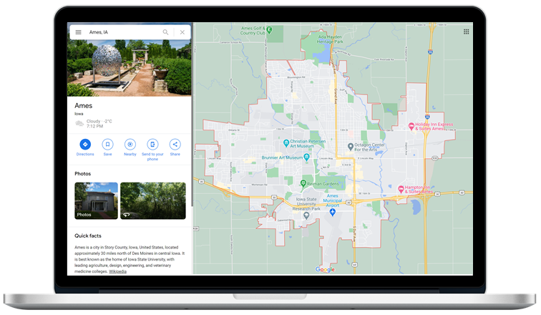
Who We Are:
Arbor | DuBois Data Science Consultants
Target Audience:
Real estate and Data Analytics Companies
Dataset:
1,460 Observations
80 Variables
1
Introduction
Notes:
Ryan

Slide 4



2
Objectives & Goals
Predict
Identify
Implement
Predict fair market value assessment for homes in Ames
Identify important features related to home sale price
Model used for price assessment of a test dataset of homes
Notes:
Marcus

Slide 5
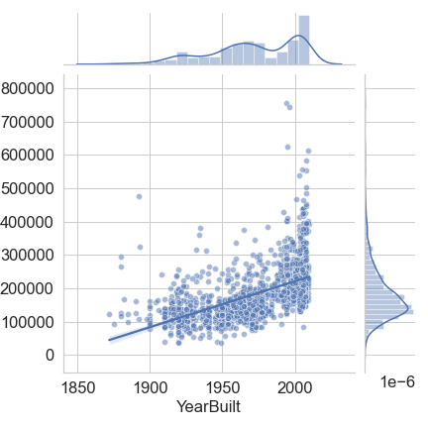
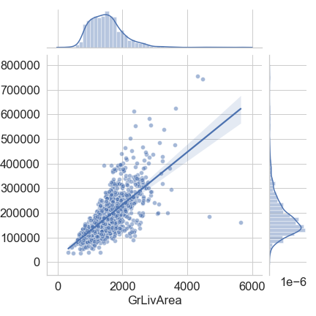
3
Dataset used to train our Machine Learning models:
1460 houses in Ames, each with 79 datapoints / features
Exploratory
Data Analysis
Sale Price ($ USD)
Year Built
Notes:
Ryan

Slide 6
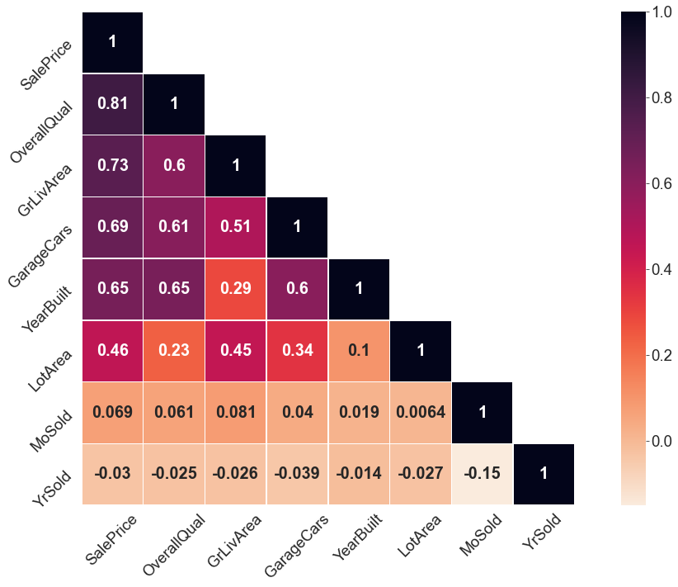
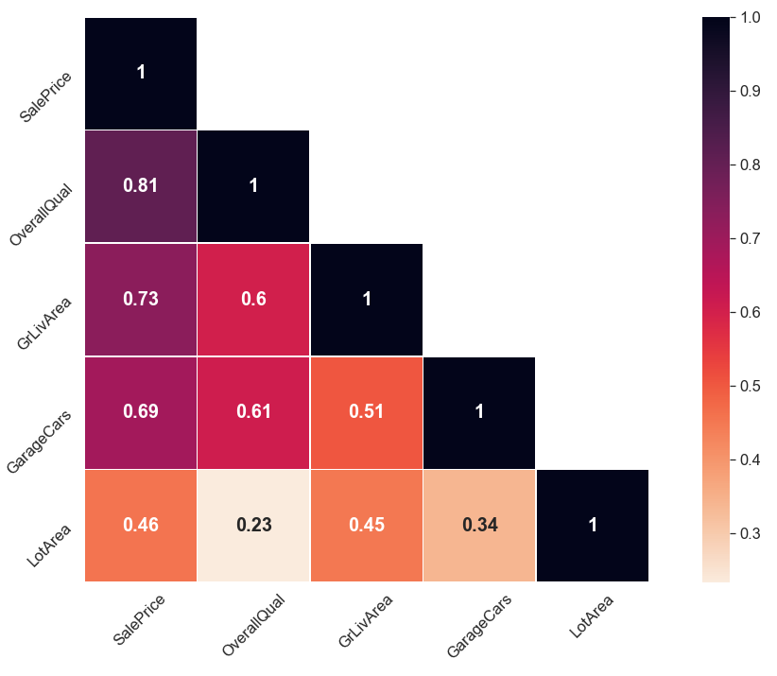
3
Exploratory
Data Analysis
Correlation (Spearman’s) between selected features
Sale Price ($ USD)
Year Built
Notes:
Ryan

Slide 7
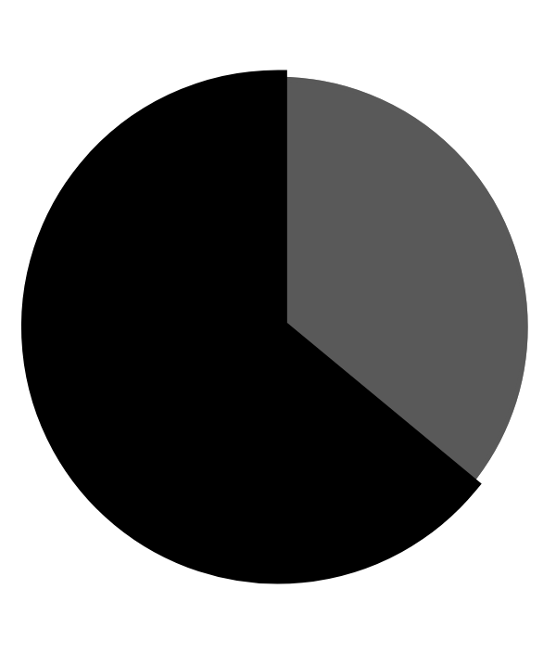
4
Pre-Processing
Imputation of missing data
36 features had missing values, generally imputed to mode value
1
Notes:
Marcus
Started with 1460 observations with 80 feautes

Slide 8
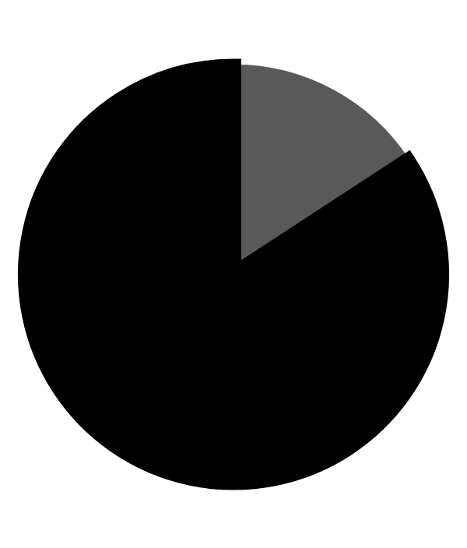
4
Pre-Processing
2
12 features
were suitable
Imputation of missing data
Encoding to ordinal
36 features had missing values, generally imputed to mode value
1
Notes:
Marcus

Slide 9

4
Pre-Processing
2
12 features
were suitable
Imputation of missing data
Encoding to ordinal
Dummification or label encoding
36 features had missing values, generally imputed to mode value
Dummification or label encoding of categorical features for use in linear models or tree-based models, respectively
1
3
Notes:
Marcus

Slide 10
4
Pre-Processing
2
logarithmic transformation of Sale Price to generate a more normal distribution
4
12 features
were suitable
Imputation of missing data
Encoding to ordinal
Dummification or label encoding
Feature transformation
36 features had missing values, generally imputed to mode value
Dummification or label encoding of categorical features for use in linear models or tree-based models, respectively
1
3
Notes:
Marcus

Slide 11
5
Feature Engineering
Aggregation
Total Outdoor SF
5 features into 1
Total Baths
4 features into 1
Simplification
House Age
YearSold - YearBuilt
Remodel/Addition Age
YearSold - YearRemodAdd
Garage Age
YearSold - GarageYearBuilt
Removal
Correlation < 0.3 with Sale Price
Features with > 90% of the same level
Electrical System
Redundant features
GarageArea, GarageCond
Features with trends that were independent of Sale Price
MonthSold and YearrSold
Notes:
Marcus
Removal 2. Ex: pavements

Slide 12
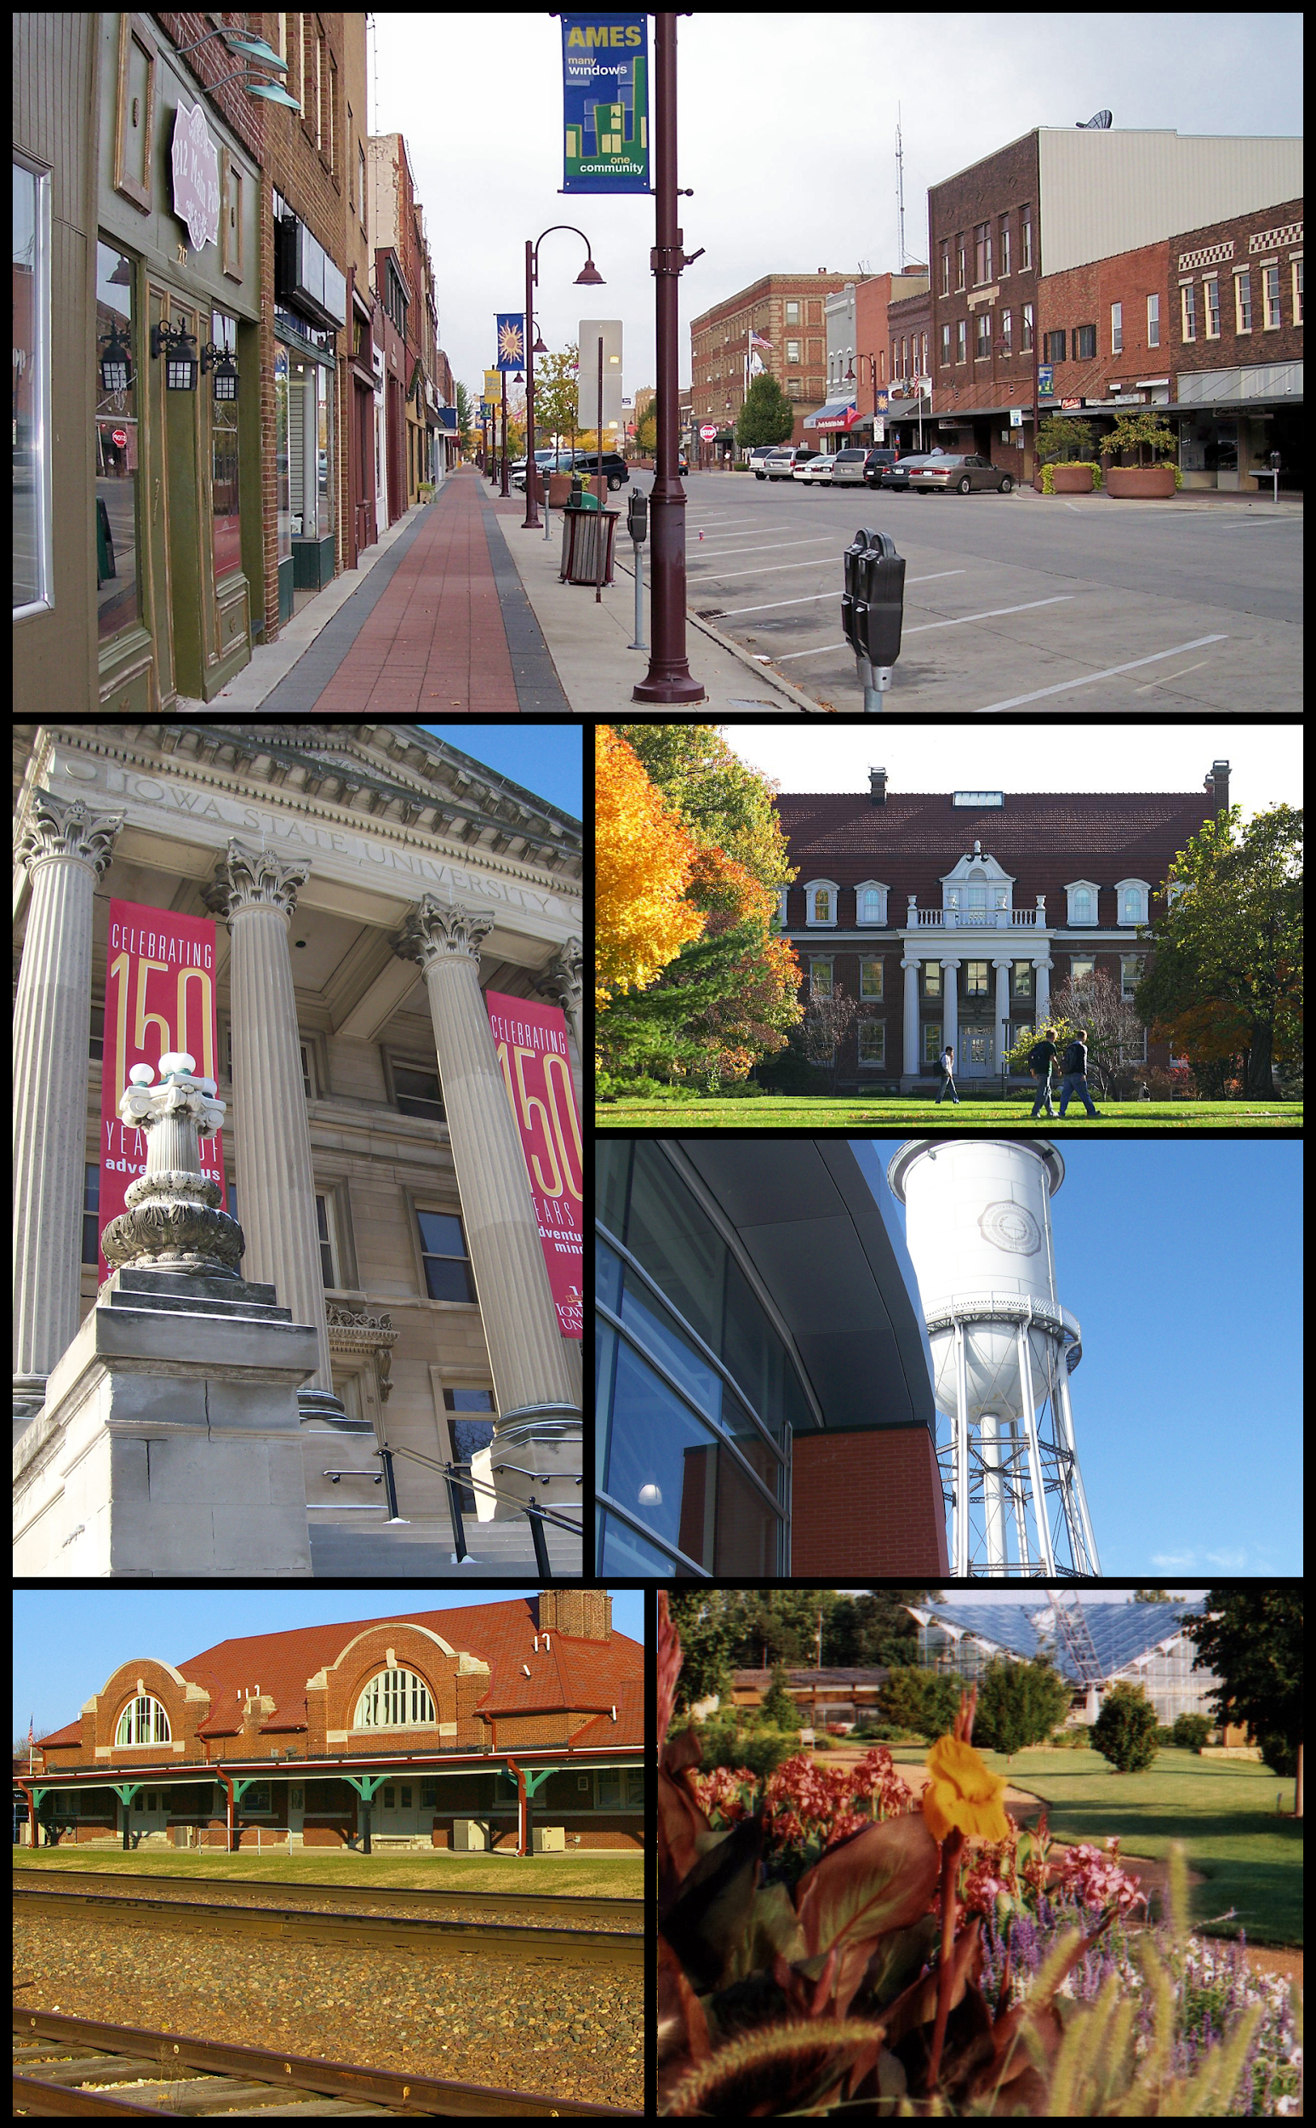
6
Machine Learning Models
Linear Regression Models
Multiple Linear Regression
Regularization
Tree-Based Models
Random Forest
Gradient Boosting
XGBoost
Notes:
Marcus
Pre-processing -> modeling -> MAE scores

Slide 13
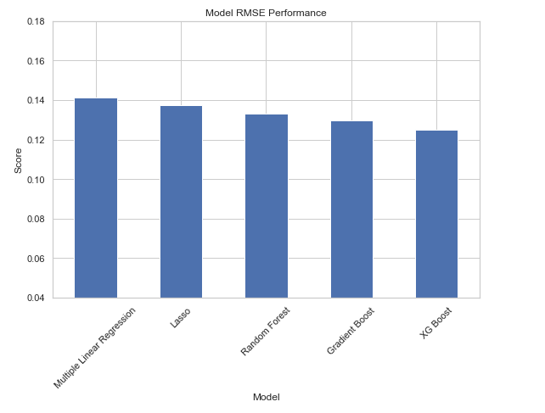
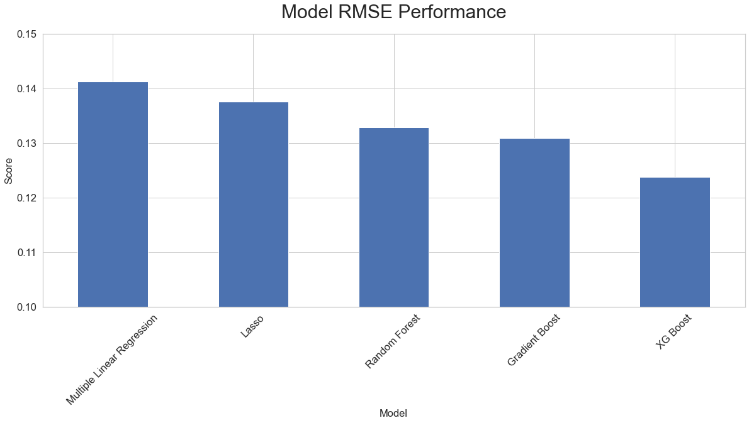
7
Model Performance
0.141
0.138
0.133
0.131
0.124
Notes:
Marcus

Slide 14
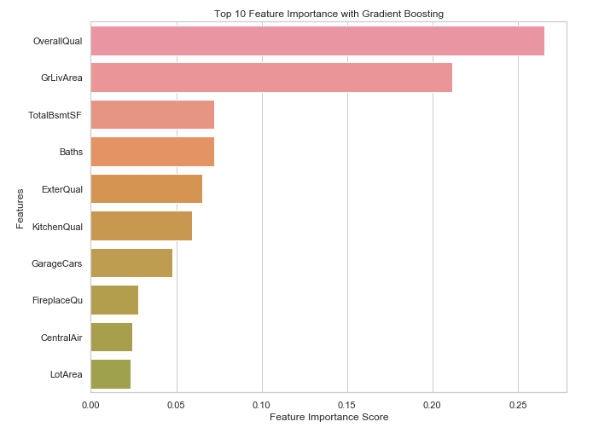
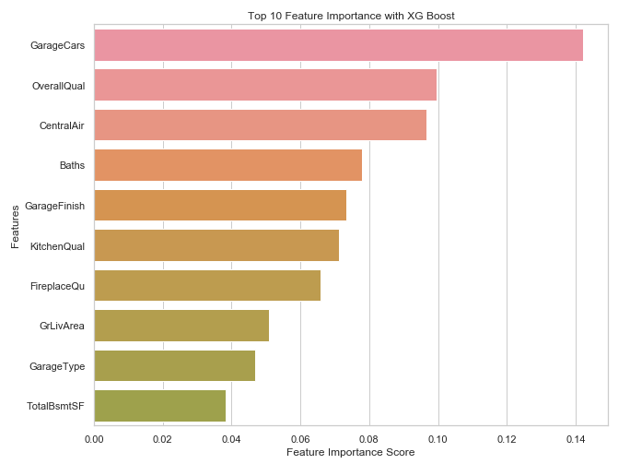
8
Feature Importance
Space holder for description
Total_Baths
Total_Baths
Notes:
Marcus - make font larger
Go over points to make for this slide

Slide 15
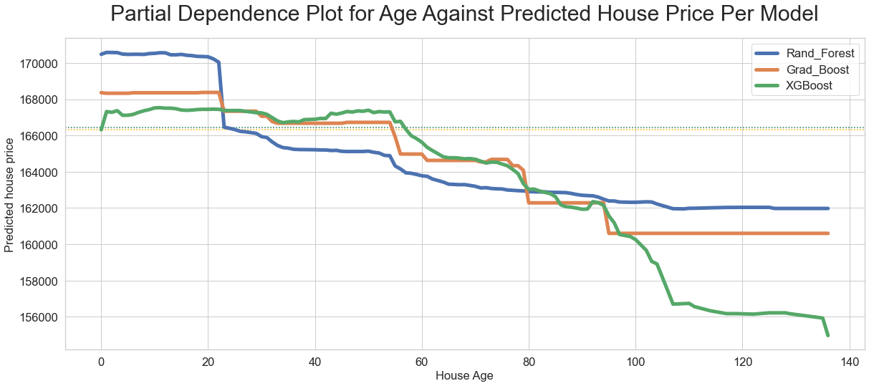
8
Dependence of Age on Prediction
Space holder for description
Space holder fr graph
Notes:
Ryan

Slide 16
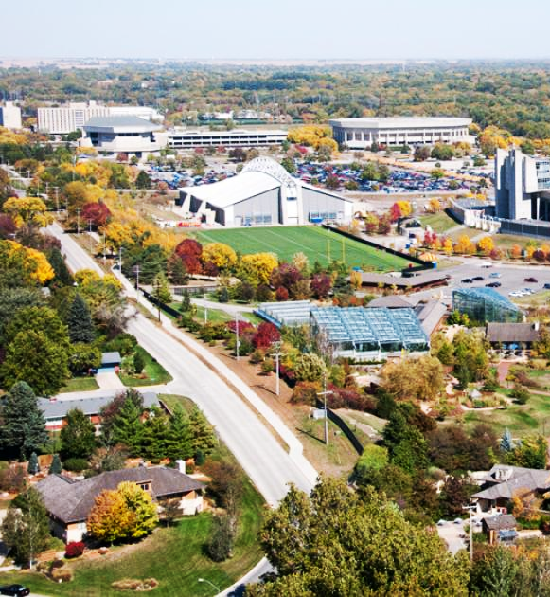

9
Insights & Conclusions
Our models predict with an average error of ~$25,000 - $32,000
Notes:
Ryan

Slide 17

9
Insights & Conclusions
Our models predict with an average error of ~$25,000 - $32,000
The predictions of our models were compared to actual sale prices
Notes:
Ryan

Slide 18
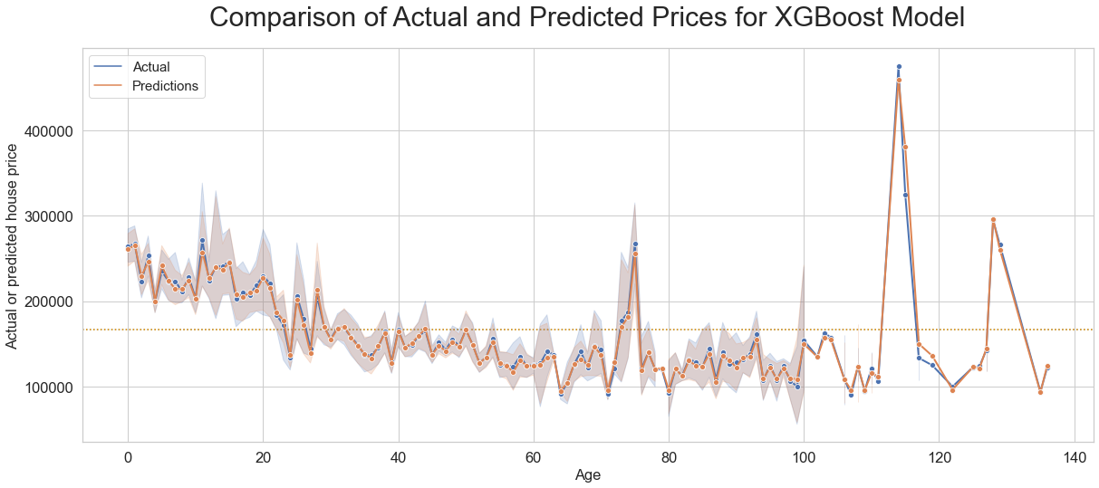
9
Insights & Conclusion
Notes:
Ryan

Slide 19
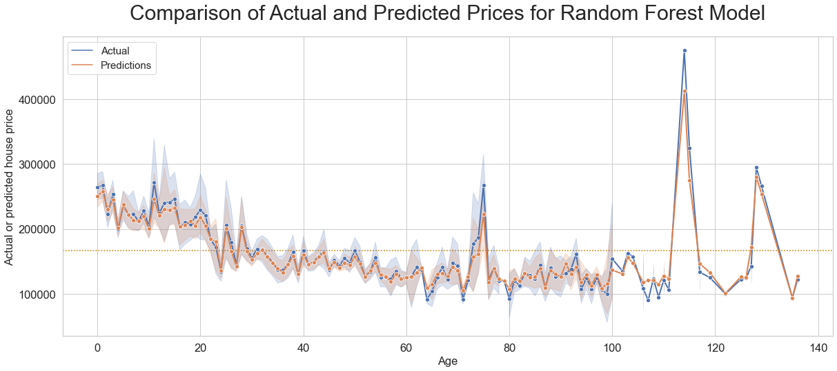
9
Insights & Conclusion
Notes:
Ryan

Slide 20
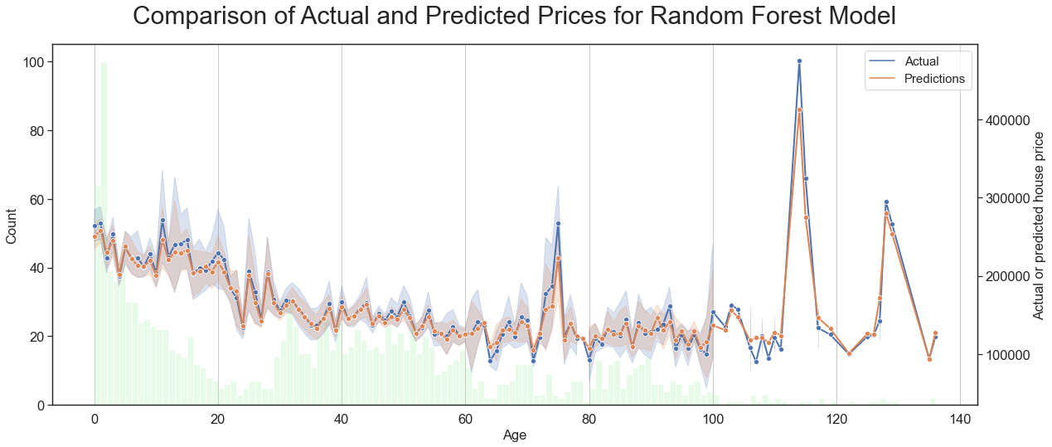
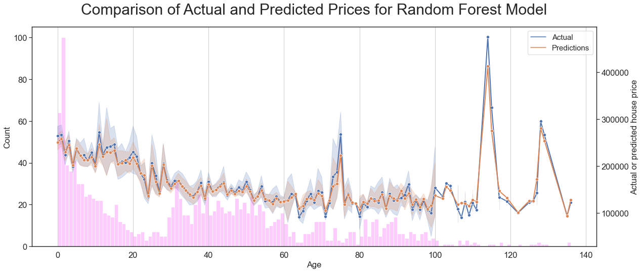
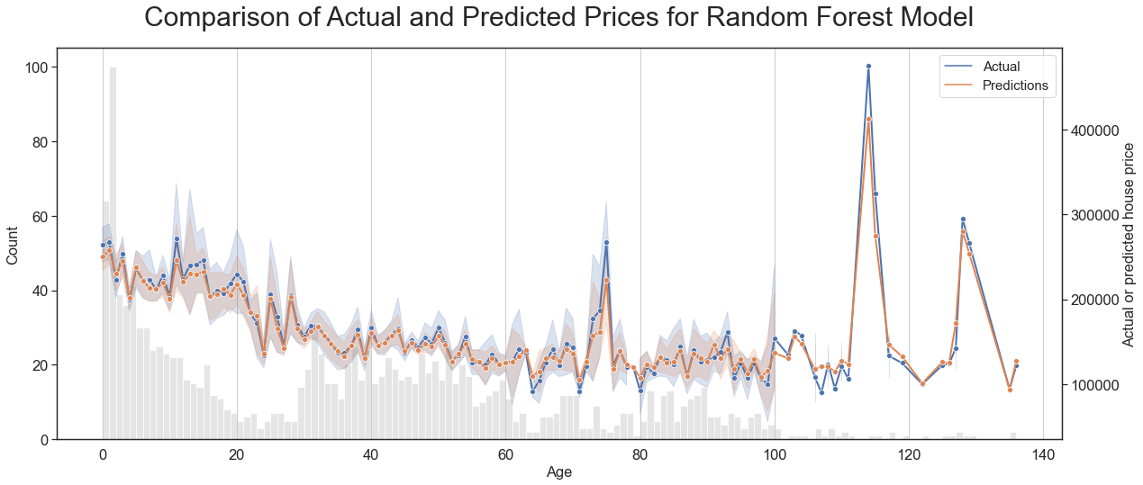
9
Insights & Conclusion
Notes:
Ryan

Slide 21

9
Insights & Conclusions
Our models predict with an average error of ~$25,000 - $32,000
The predictions of our models were compared to actual sale prices
Comparisons revealed a distinct dependence on age, which was directly related to the number of houses used to train the model for a given year
Notes:
Ryan

Slide 22
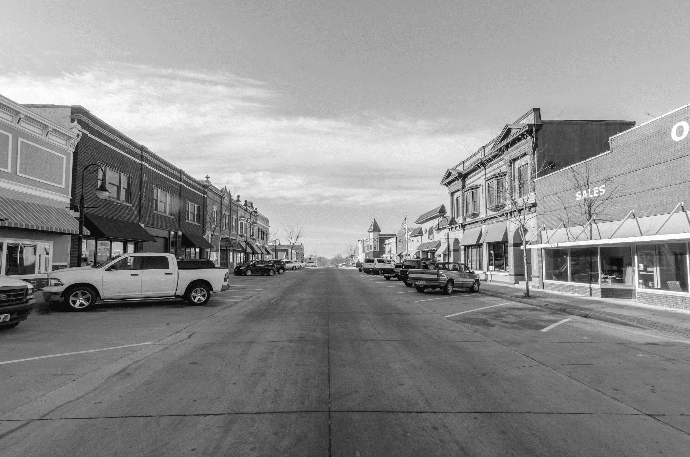

10
Future Work
Apply other machine learning algorithms such as Naive Bayes and Support Vector Machine
Notes:
Ryan

Slide 23
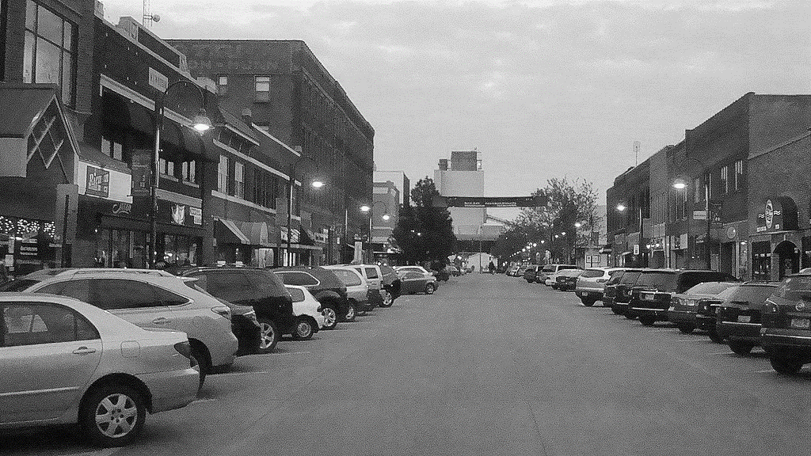

10
Future Work
Apply other machine learning algorithms such as Naive Bayes and Support Vector Machine
Accumulate more data on features in modern homes to incorporate into the algorithms (ie. smart homes, energy efficiency/production, transportation)
Notes:
Ryan

Slide 24


10
Future Work
Apply other machine learning algorithms such as Naive Bayes and Support Vector Machine
Accumulate more data on features in modern homes to incorporate into the algorithms (ie. smart homes, energy efficiency/production, transportation)
Develop specific, targeted submodels to more accurately assess values for houses in different age groups
Notes:
Ryan

Slide 25
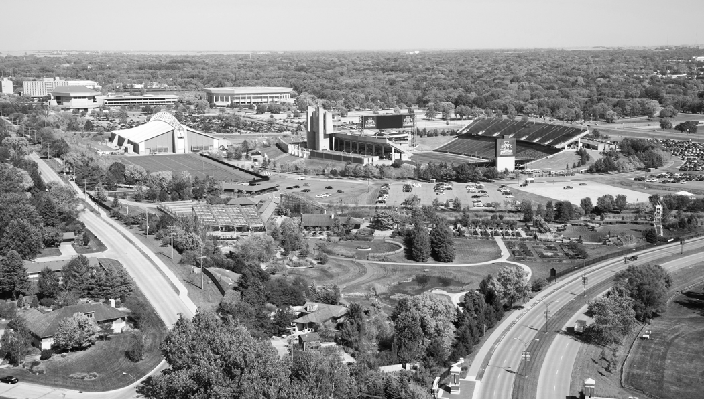
THANK YOU

Slide 26
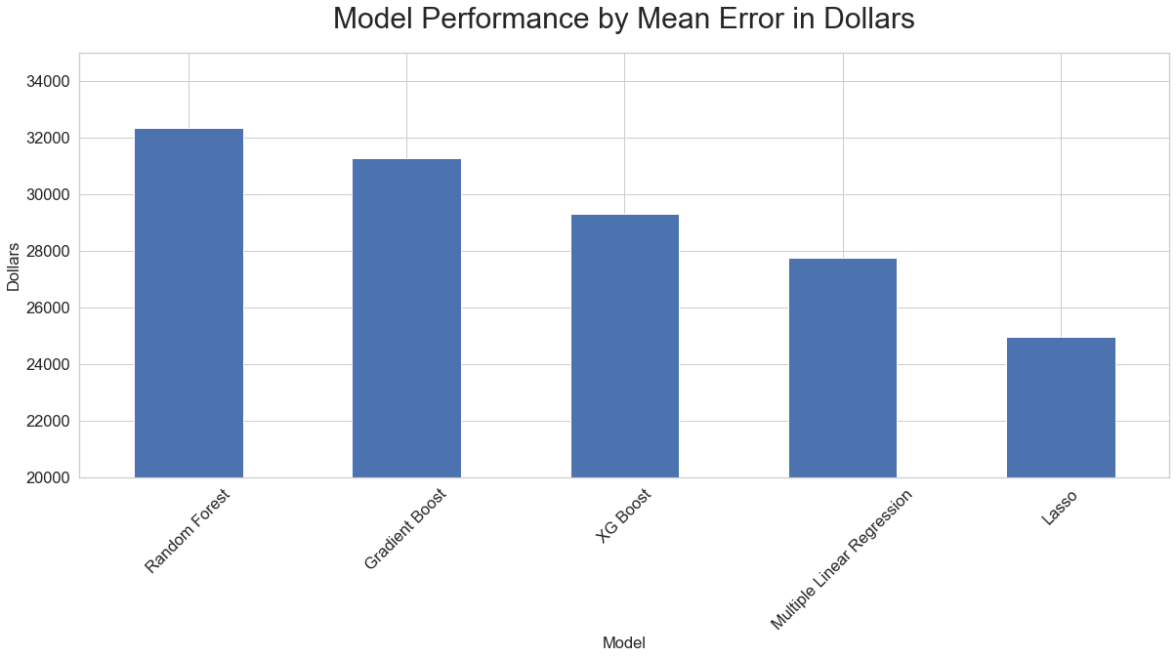
7
Model Performance
0.141
0.137
0.132
0.129
0.125
Notes:
Marcus

Slide 27
6
MLR fitting
Modeling:
Linear Regression
Cook’s IOI
VIF
IO removal
Process outline:
Refit MLR
Lasso
Ridge
Feature Selection
Refit Lasso
Refit Lasso with IO removed
VIF

Slide 28
6
Modeling: Tree-based
Random Forest
Gradient Boosting
XGBoost
RF fitting
GB fitting
XGB fitting
Randomized search, 6 hyperparams
Grid Search
Randomized search, 7 hyperparams
Grid Search, 6 hyperparams
Feature importance
Grid Search, 7 hyperparams
Feature importance
Feature importance

